Slide 1
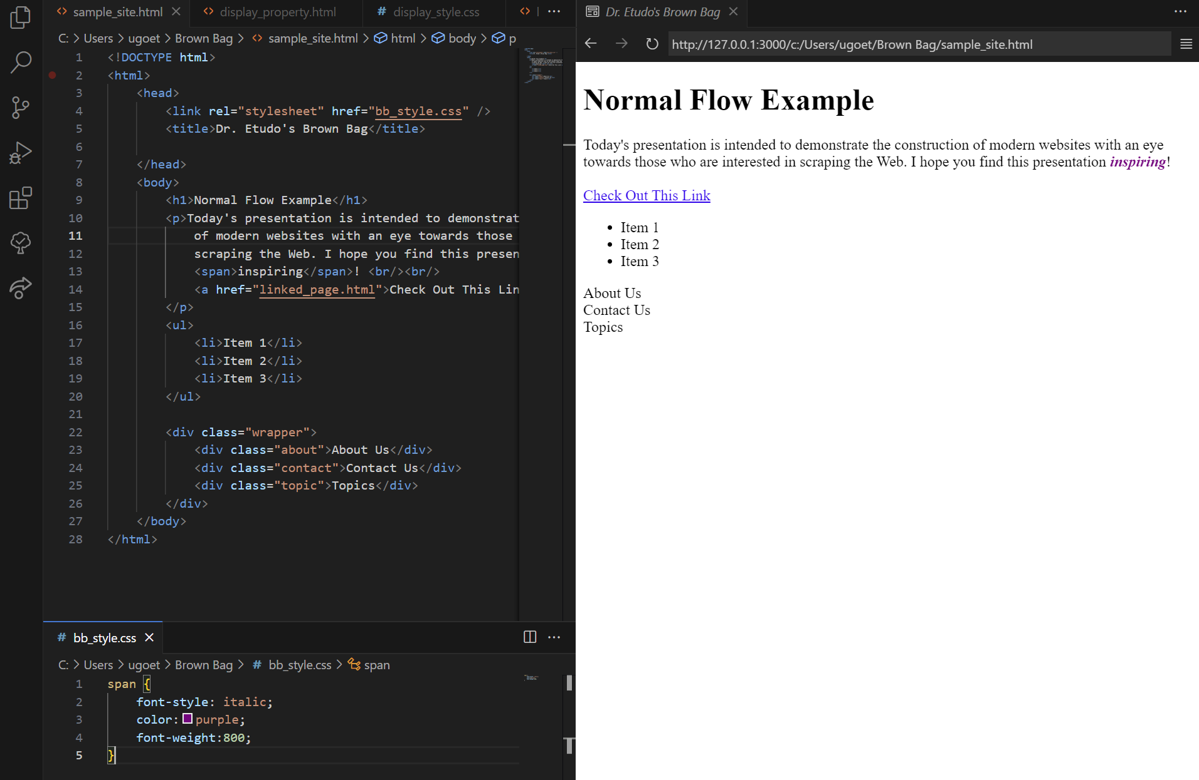

Slide 2
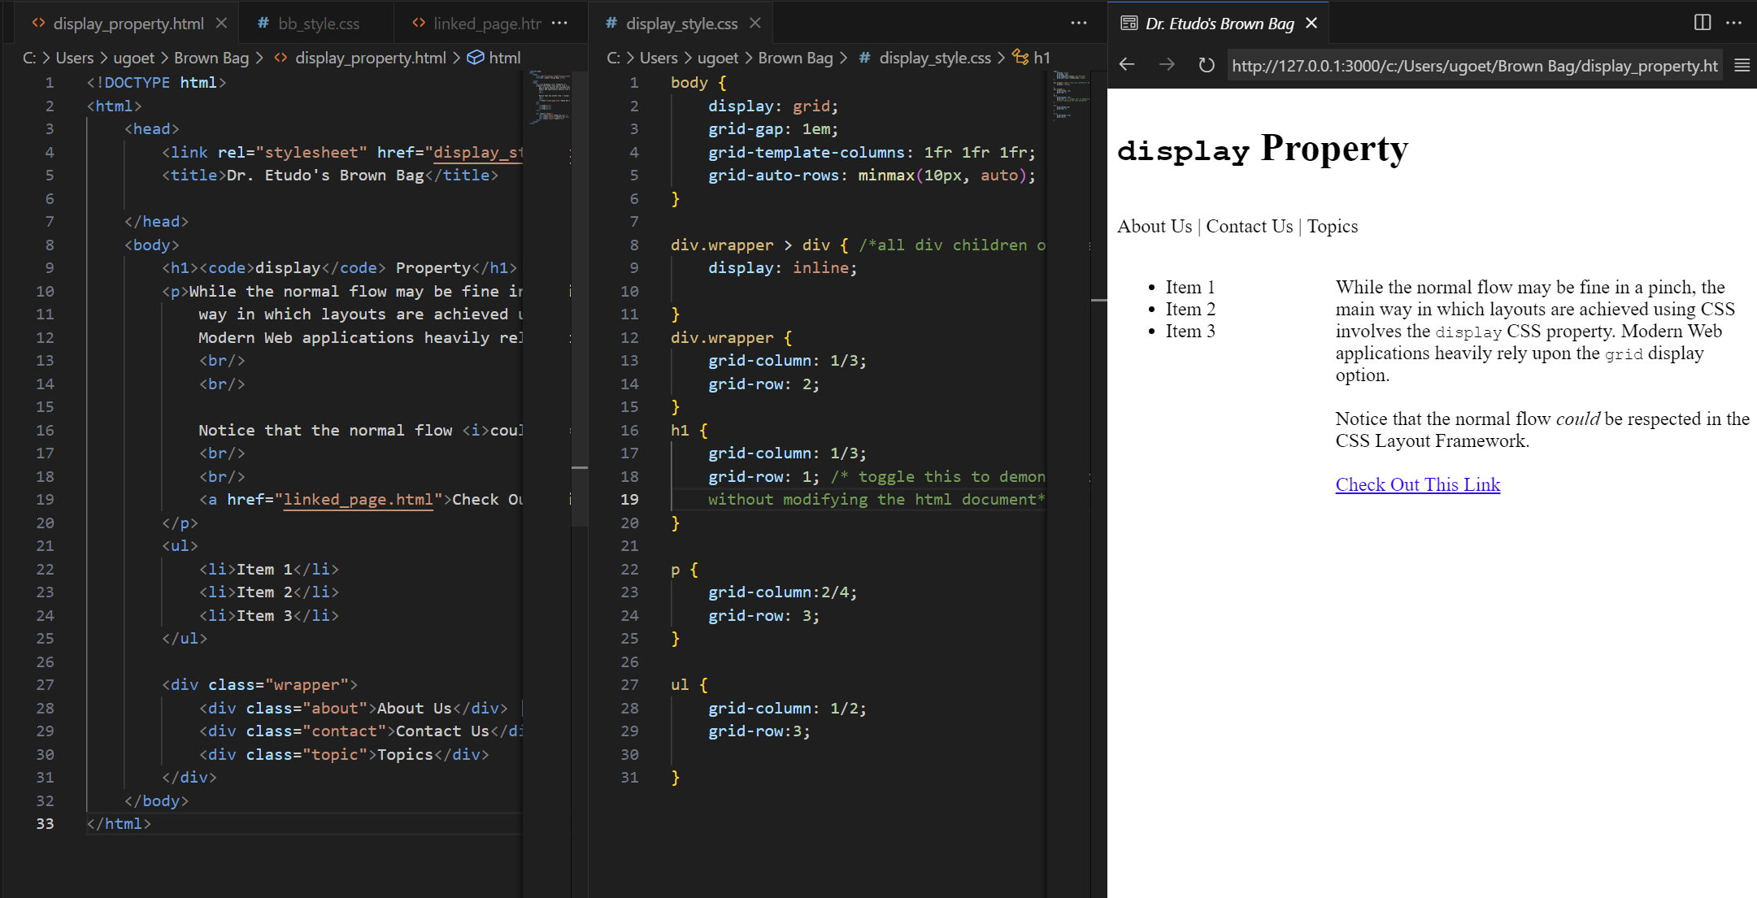

Slide 3
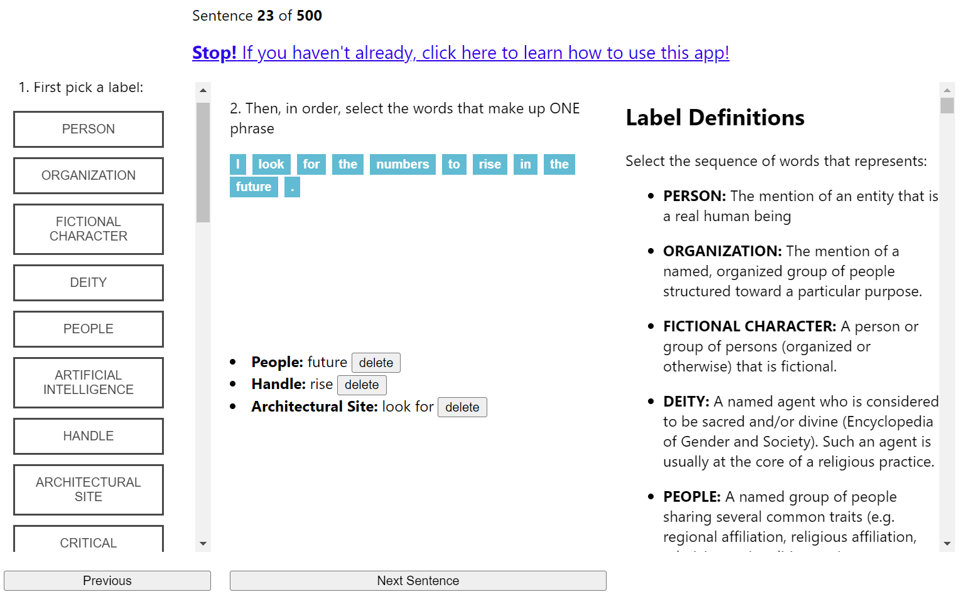
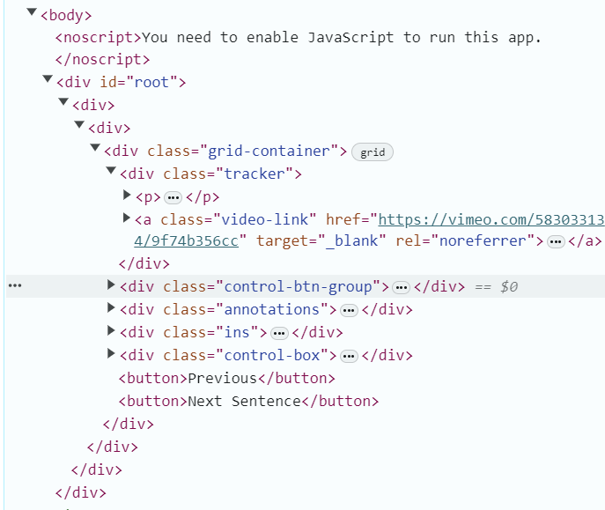
Example: HTML Documents Are Misleading

Slide 4
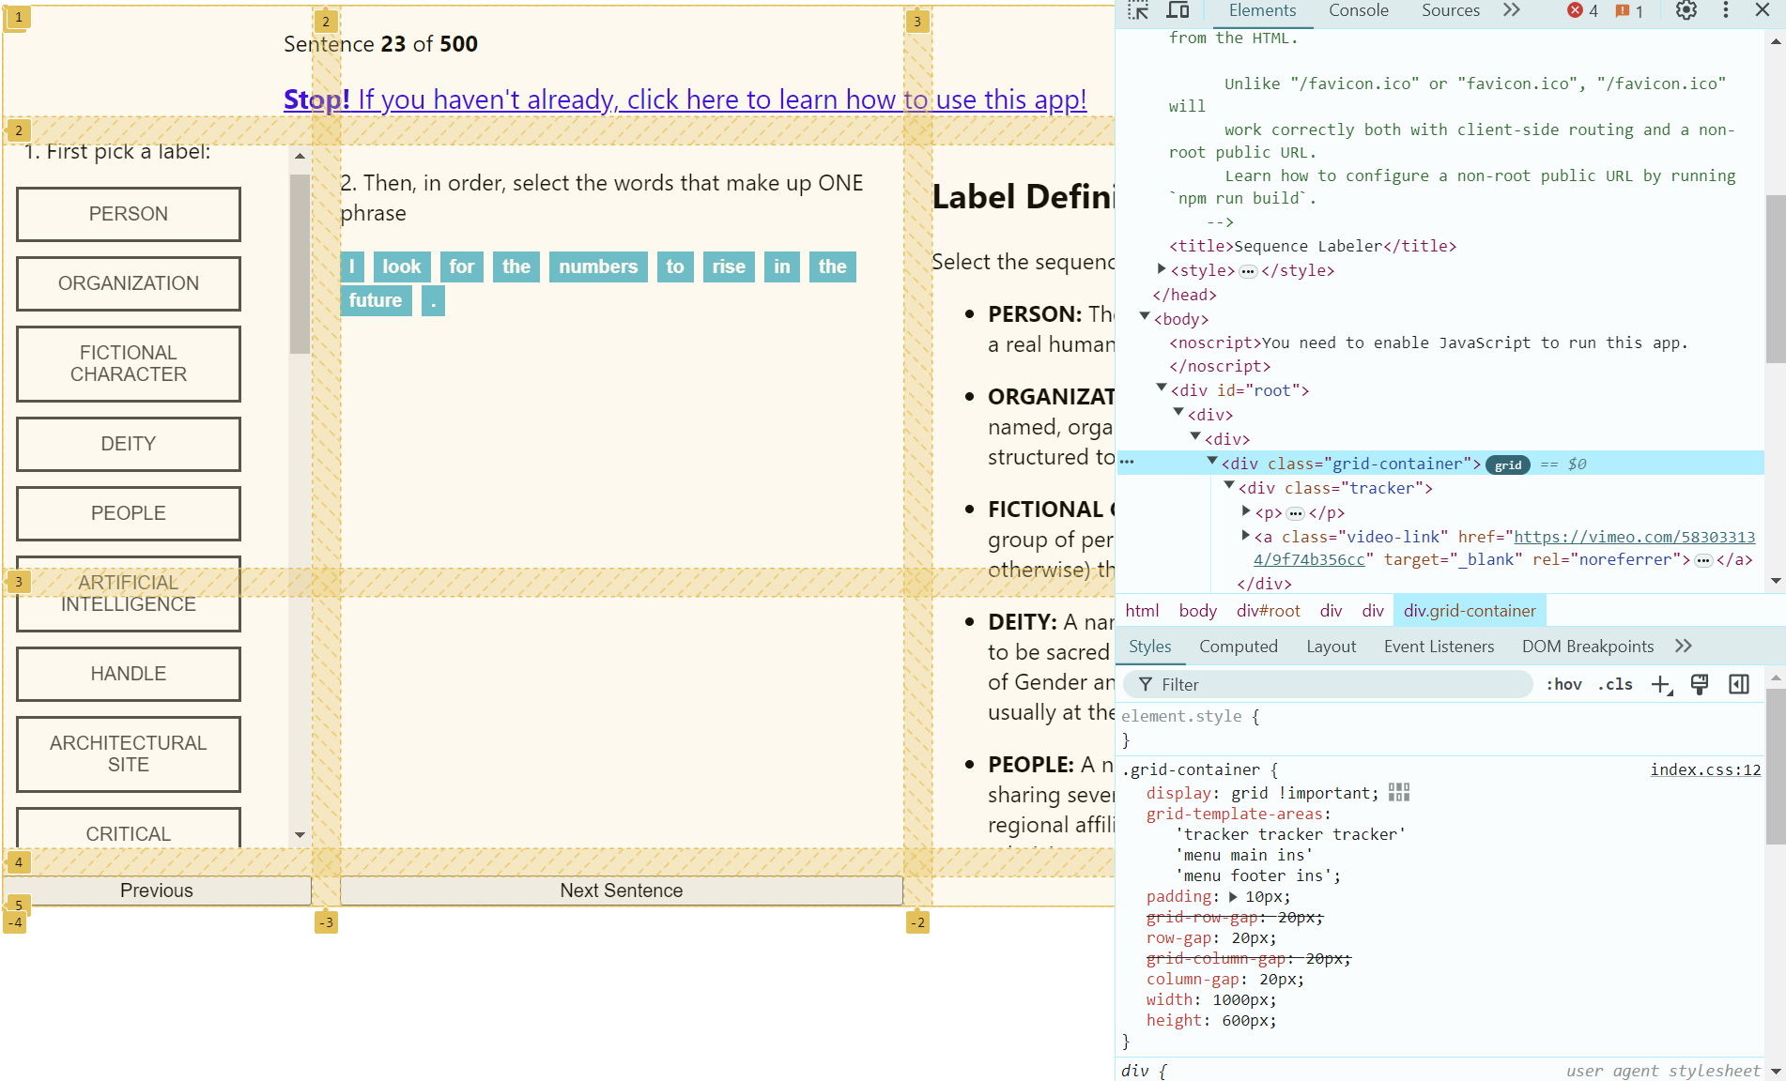

Slide 5
tracker
tracker
tracker
menu
main
ins
menu
footer
ins

Slide 6
Extracting Grid Information
from selenium import webdriver from selenium.webdriver.common.by import By from selenium.webdriver.support.wait import WebDriverWait from selenium.webdriver.support import expected_conditions as EC driver = webdriver.Chrome(executable_path=r"C:\Users\ugoet…chromedriver-win64\chromedriver.exe") driver.get("https://sequence-labeler-ui-dot-wilder-.../entity_recog?htid=325&workerId=Ugo") try: elem = WebDriverWait(driver, 10).until(EC.presence_of_element_located((By.CLASS_NAME, "grid-container"))) print(elem.value_of_css_property("font-size")) print(elem.value_of_css_property("display")) print(elem.value_of_css_property("grid-template-areas")) finally: driver.close()
16px
grid
"tracker tracker tracker" "menu main ins" "menu footer ins"

Slide 7
Final Thoughts on Display
Note that when display=grid and display=flex are not used, we can assume that the normal flow is in use
When this is case, we can expect that the order of appearance in html documents is roughly representative of the order of appearance on the browser

Slide 8
Responsive Design
Be cognizant of the view-port size when scraping
@media (max-width: 1250px) {
/* … */
}
The size of the viewport can drastically change the rendering order on the page without influencing the HTML document

Slide 9
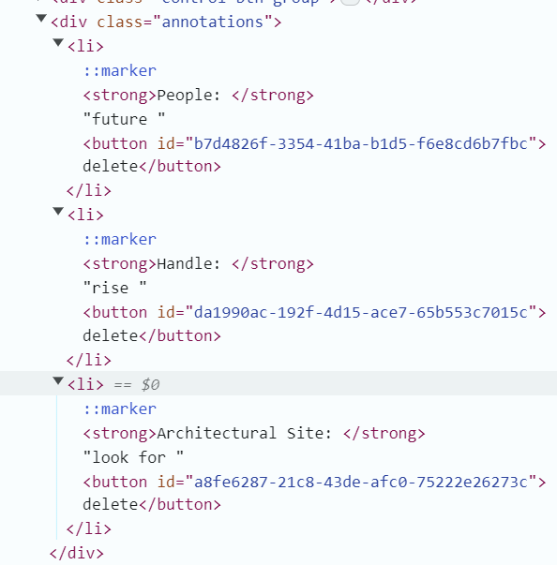
How Data is Stored and Displayed
Repeating Groups are a sure-fire sign that you might be looking at dynamic content (i.e. likely data)

Slide 10
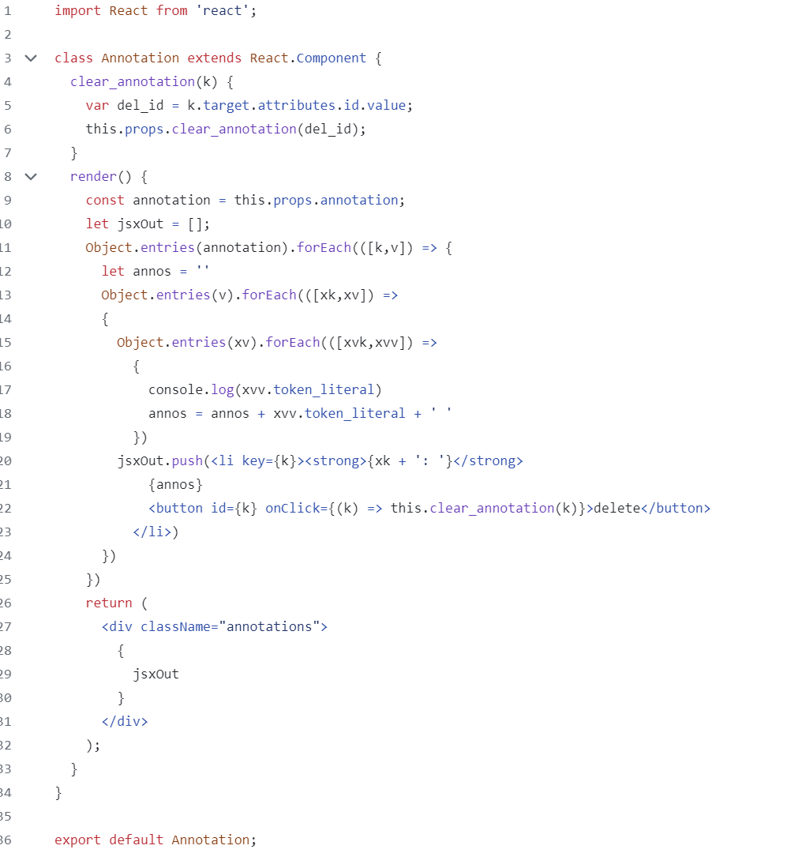
Typical Pattern for Generating Repeating Groups using React.js

Slide 11
A Note on CMS
Content Management Systems (CMS) are often delivered with websites
Most would be familiar with Wordpress
They allow the owning entity to decide what pages and what content should be displayed where
Some CMSs allow for the rapid development of websites
These tools tend to create large, slow Web Applications, but they can also be a source of regularities for the scraper
If you can infer where the footer is, you may be able to infer the CMS vendor

